Slide 1
Global Stocktake ClimateDatathon 2022
Team name: Utopia
Members: Ratanon Suksumrun, Jidapa Tangsuksavangporn, Kalayachat Vichitkarnchana, Chesed Mercado

Slide 2
AGenda
Prompt Introduction
Industry Emissions Scope scorecard
Robustness Scorecard
Bottomline

Slide 3
Prompt: Net-Zero CO₂eq and GHG Targets
The main goal of the prompt is to be able to address the big question of “How can analysis and visualization of publicly available data be used to further map the ambition of current net-zero CO2eq or GHG non-state actor targets/commitments?”
In this slide deck, we will be detailing our approaches on the prompt, using the Net Zero tracker dataset as the baseline.
This submission includes a Tableau Public and Power BI files that will detail the visualization and analysis that we would like to present

Slide 4
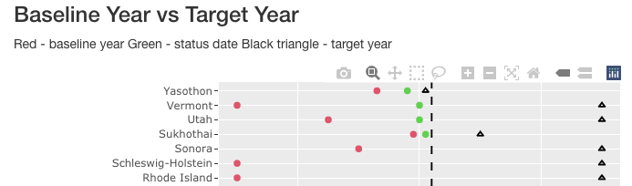
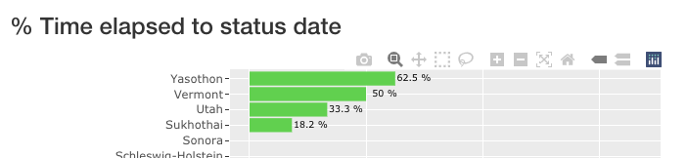
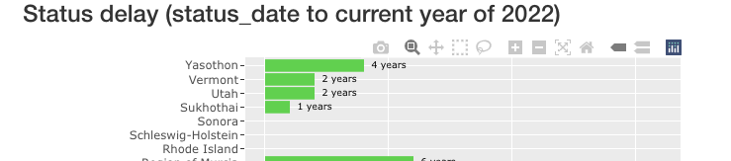
VISUALIZING EMISSION REDUCTIONS AMBITION BASED ON TARGET DATES
Emission reduction targets are a key component of the mitigation ambition of NSAs. We created a notebook that visualizes the NetZero Tracker dataset which can be downloaded from https://zerotracker.net.
The analysis shows progress towards the target date by different types of NSAs (Cities, Regions, Companies), and allows a comparison of different NSAs.
Baseline Year vs Target Year shows NSAs progress towards their respective target year.
Percentage Time elapsed to status date shows how close they are to their target year. Assuming they are on track
Status delay takes reference from the current year to track progress to target year. A high score on this graph represents NSAs that either need a status update (status is delayed).

Slide 5
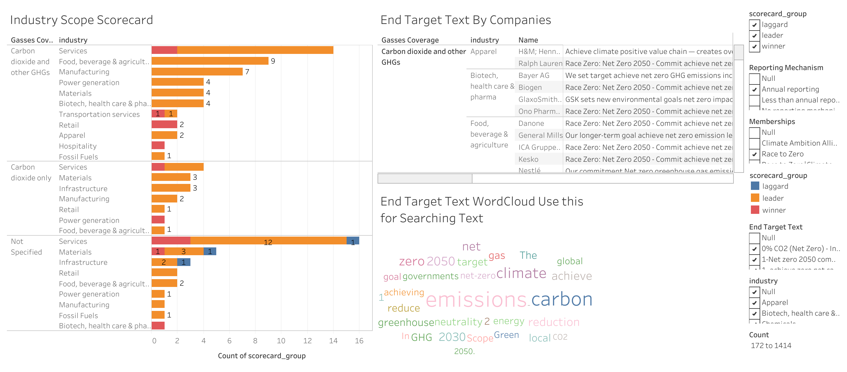
InDUSTRY EMISSIONS SCOPE SCORECARD

Slide 6
InDUSTRY EMISSIONS SCOPE SCORECARD
The hypothesis was to identify which companies/industries are the leaders, winners and laggards in disclosing their scope 1, 2 and 3 emissions. Once the scope categories are identified, an end target text dashboard was also shown to track the companies’ ambitions so that the scope categories are aligned with the companies’ end target text.
Companies with good ambition should at least have a consistent disclosure on their scope emissions. We would like to group the companies using a scope scorecard. This also includes what gasses the entities have covered and if there are part of any membership. This can potentially influence the trend and analysis that can derived from the dashboards.
The approach in conducting this analysis was to quantify the multiple choice values of Scope 1,2 and 3. The numerical quantification is based on Net Zero Tracker’s methodology¹ in scoring companies’ track for ambition.
Link to access the Scope Scorecard dashboard: https://public.tableau.com/app/profile/tap.suksumrun/viz/GlobalStockTakeNetZeroDatathon2022-Master/ScopeScorecardDashboard#2
Notes:
1. https://www.net0tracker.org/faq.html/#methodology

Slide 7
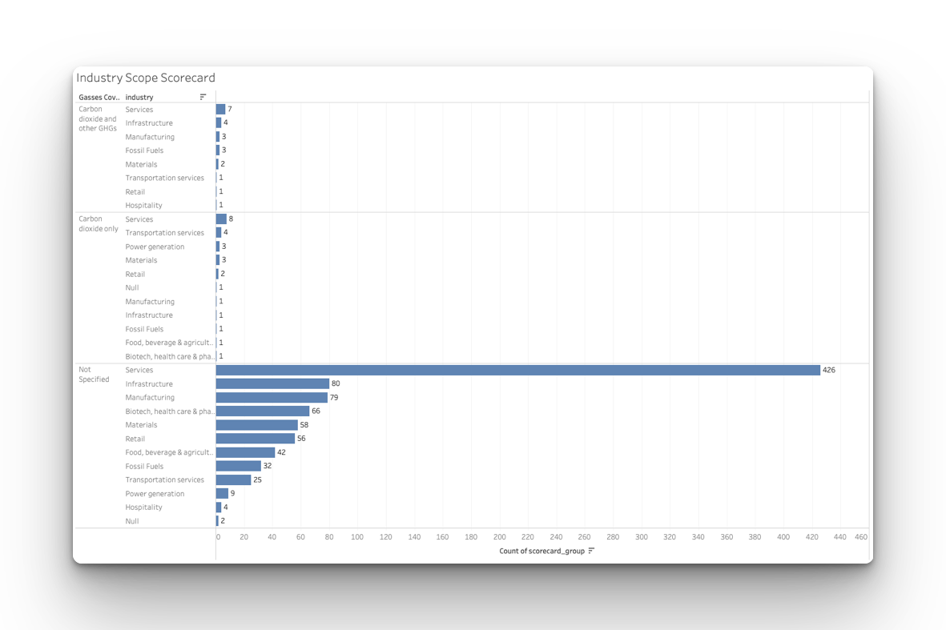
InDUSTRY EMISSIONS SCOPE SCORECARD
Filters applied: All reporting mechanism, null membership and laggard
Visualization from the data shows the laggard proportion are mostly entities that do not disclose both of their scope emissions and what gasses they cover. This is especially true when the entities are not part of any membership intiative.
So there is a trend that companies that are not part of any climate membership initiative would indicate that companies have some inconsitencies in their ambition tracking despite that the companies claim that they also report annual reporting mechanism
To increase the scorecard further, companies would need to be more transparent in their reporting mechanism and specify what gasses they cover in order to be eligible that the companies are on track for their ambition
Notes:
1. https://www.net0tracker.org/faq.html/#methodology

Slide 8
InDUSTRY EMISSIONS SCOPE SCORECARD: so then?
To increase the scorecard further, companies would need to be more transparent and active in their scope,1,2 and 3 emissions in order to be inline with their reporting mechanism, as some companies are laggards even if they disclose an annual reporting mechanism.
To further improve this, it is also detrimental to specify the gasses covered in the scope emissions as a track on companies’ ambition
A stringent environmental policy on companies in disclosing their scope emissions should be enpassed along with any penalty if companies fail to do so.
Promote and advertise companies to be part of a climate membership initiative, this would allow companies to be more active and strict to the memberships’ policies and actions.
Notes:
1. https://www.net0tracker.org/faq.html/#methodology

Slide 9
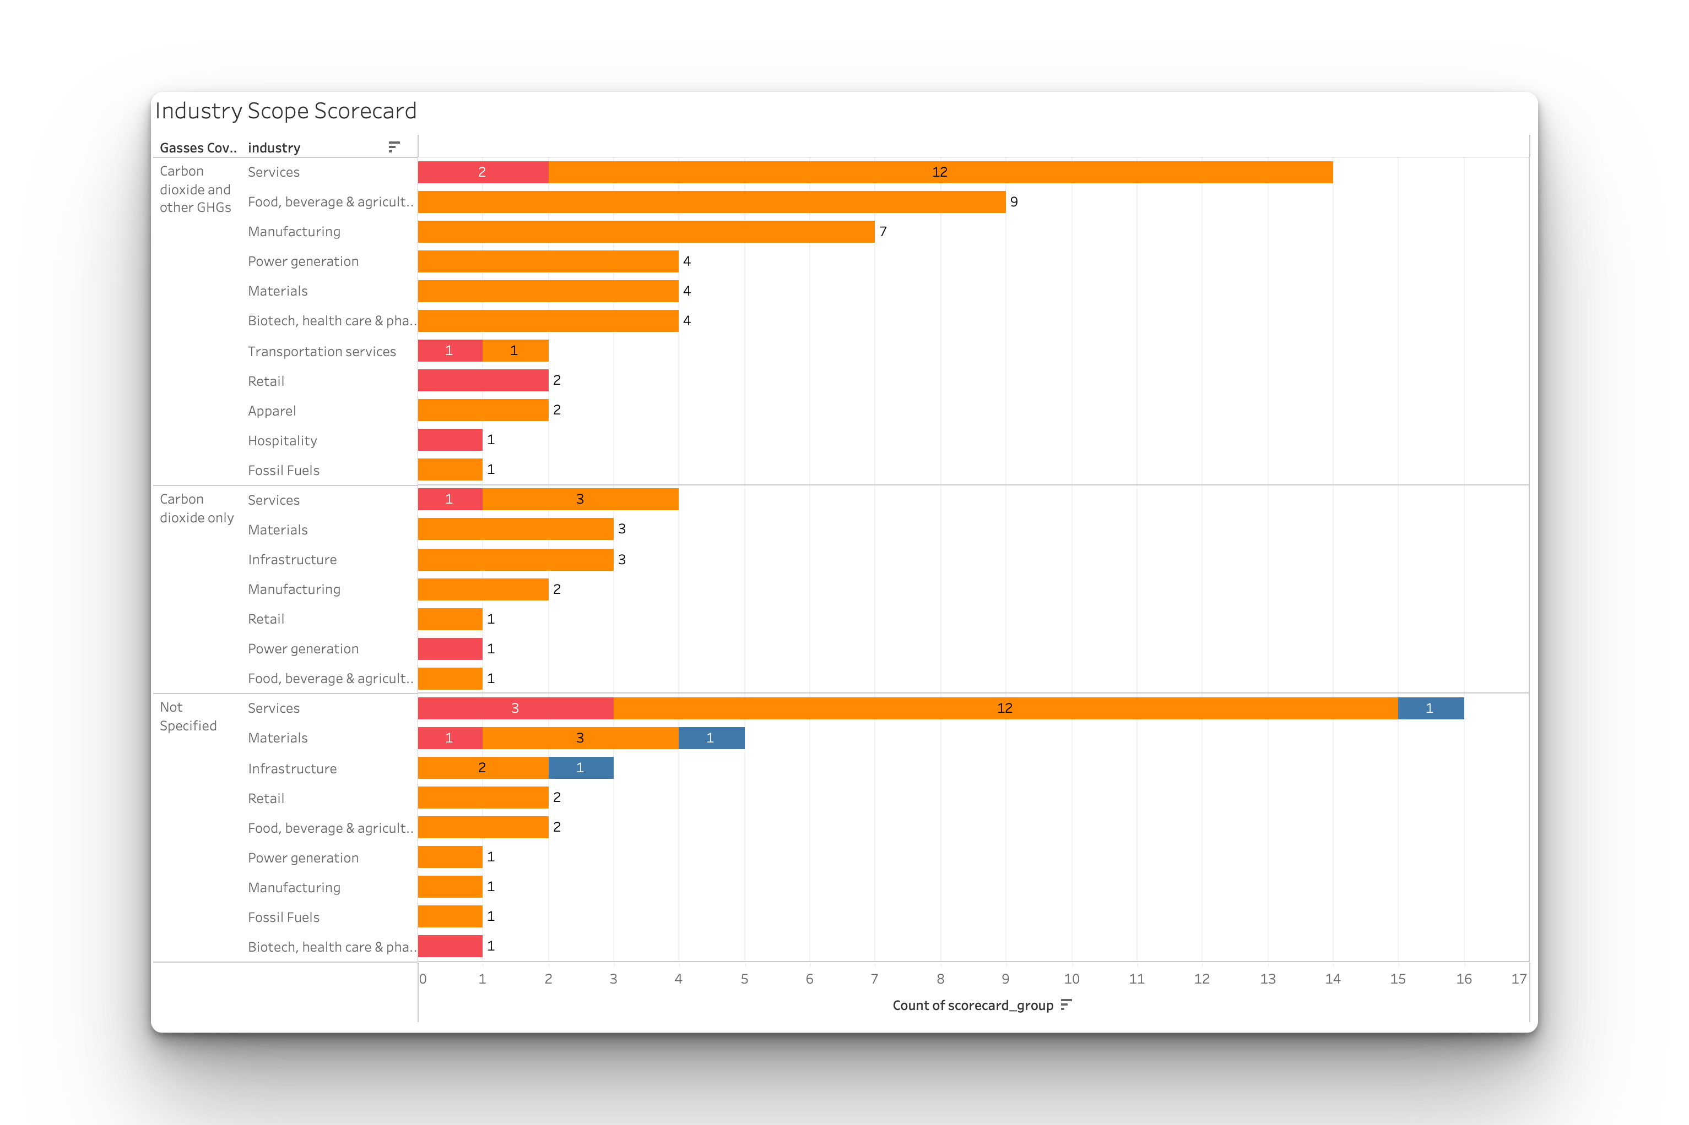
InDUSTRY EMISSIONS SCOPE SCORECARD
Filters applied: Annual reporting, Race to Zero and all scorecard groups
Visualization from the data shows the leaders and winners proportion are mostly entities that are part of the “Race To Zero” membership
This would indicate that the scope scorecard for winners and leaders are prevalent for companies with a Race To Zero membership, they would also tend to provide an annual reporting mechanism, which is consistent with their scope emissions disclosure.
With the above filters, the population for entities that cover CO₂ and other GHG gases increased compared to the previous segment where entities are not part of any climate membership and does not disclose reporting mechanism
Notes:
1. https://www.net0tracker.org/faq.html/#methodology

Slide 10
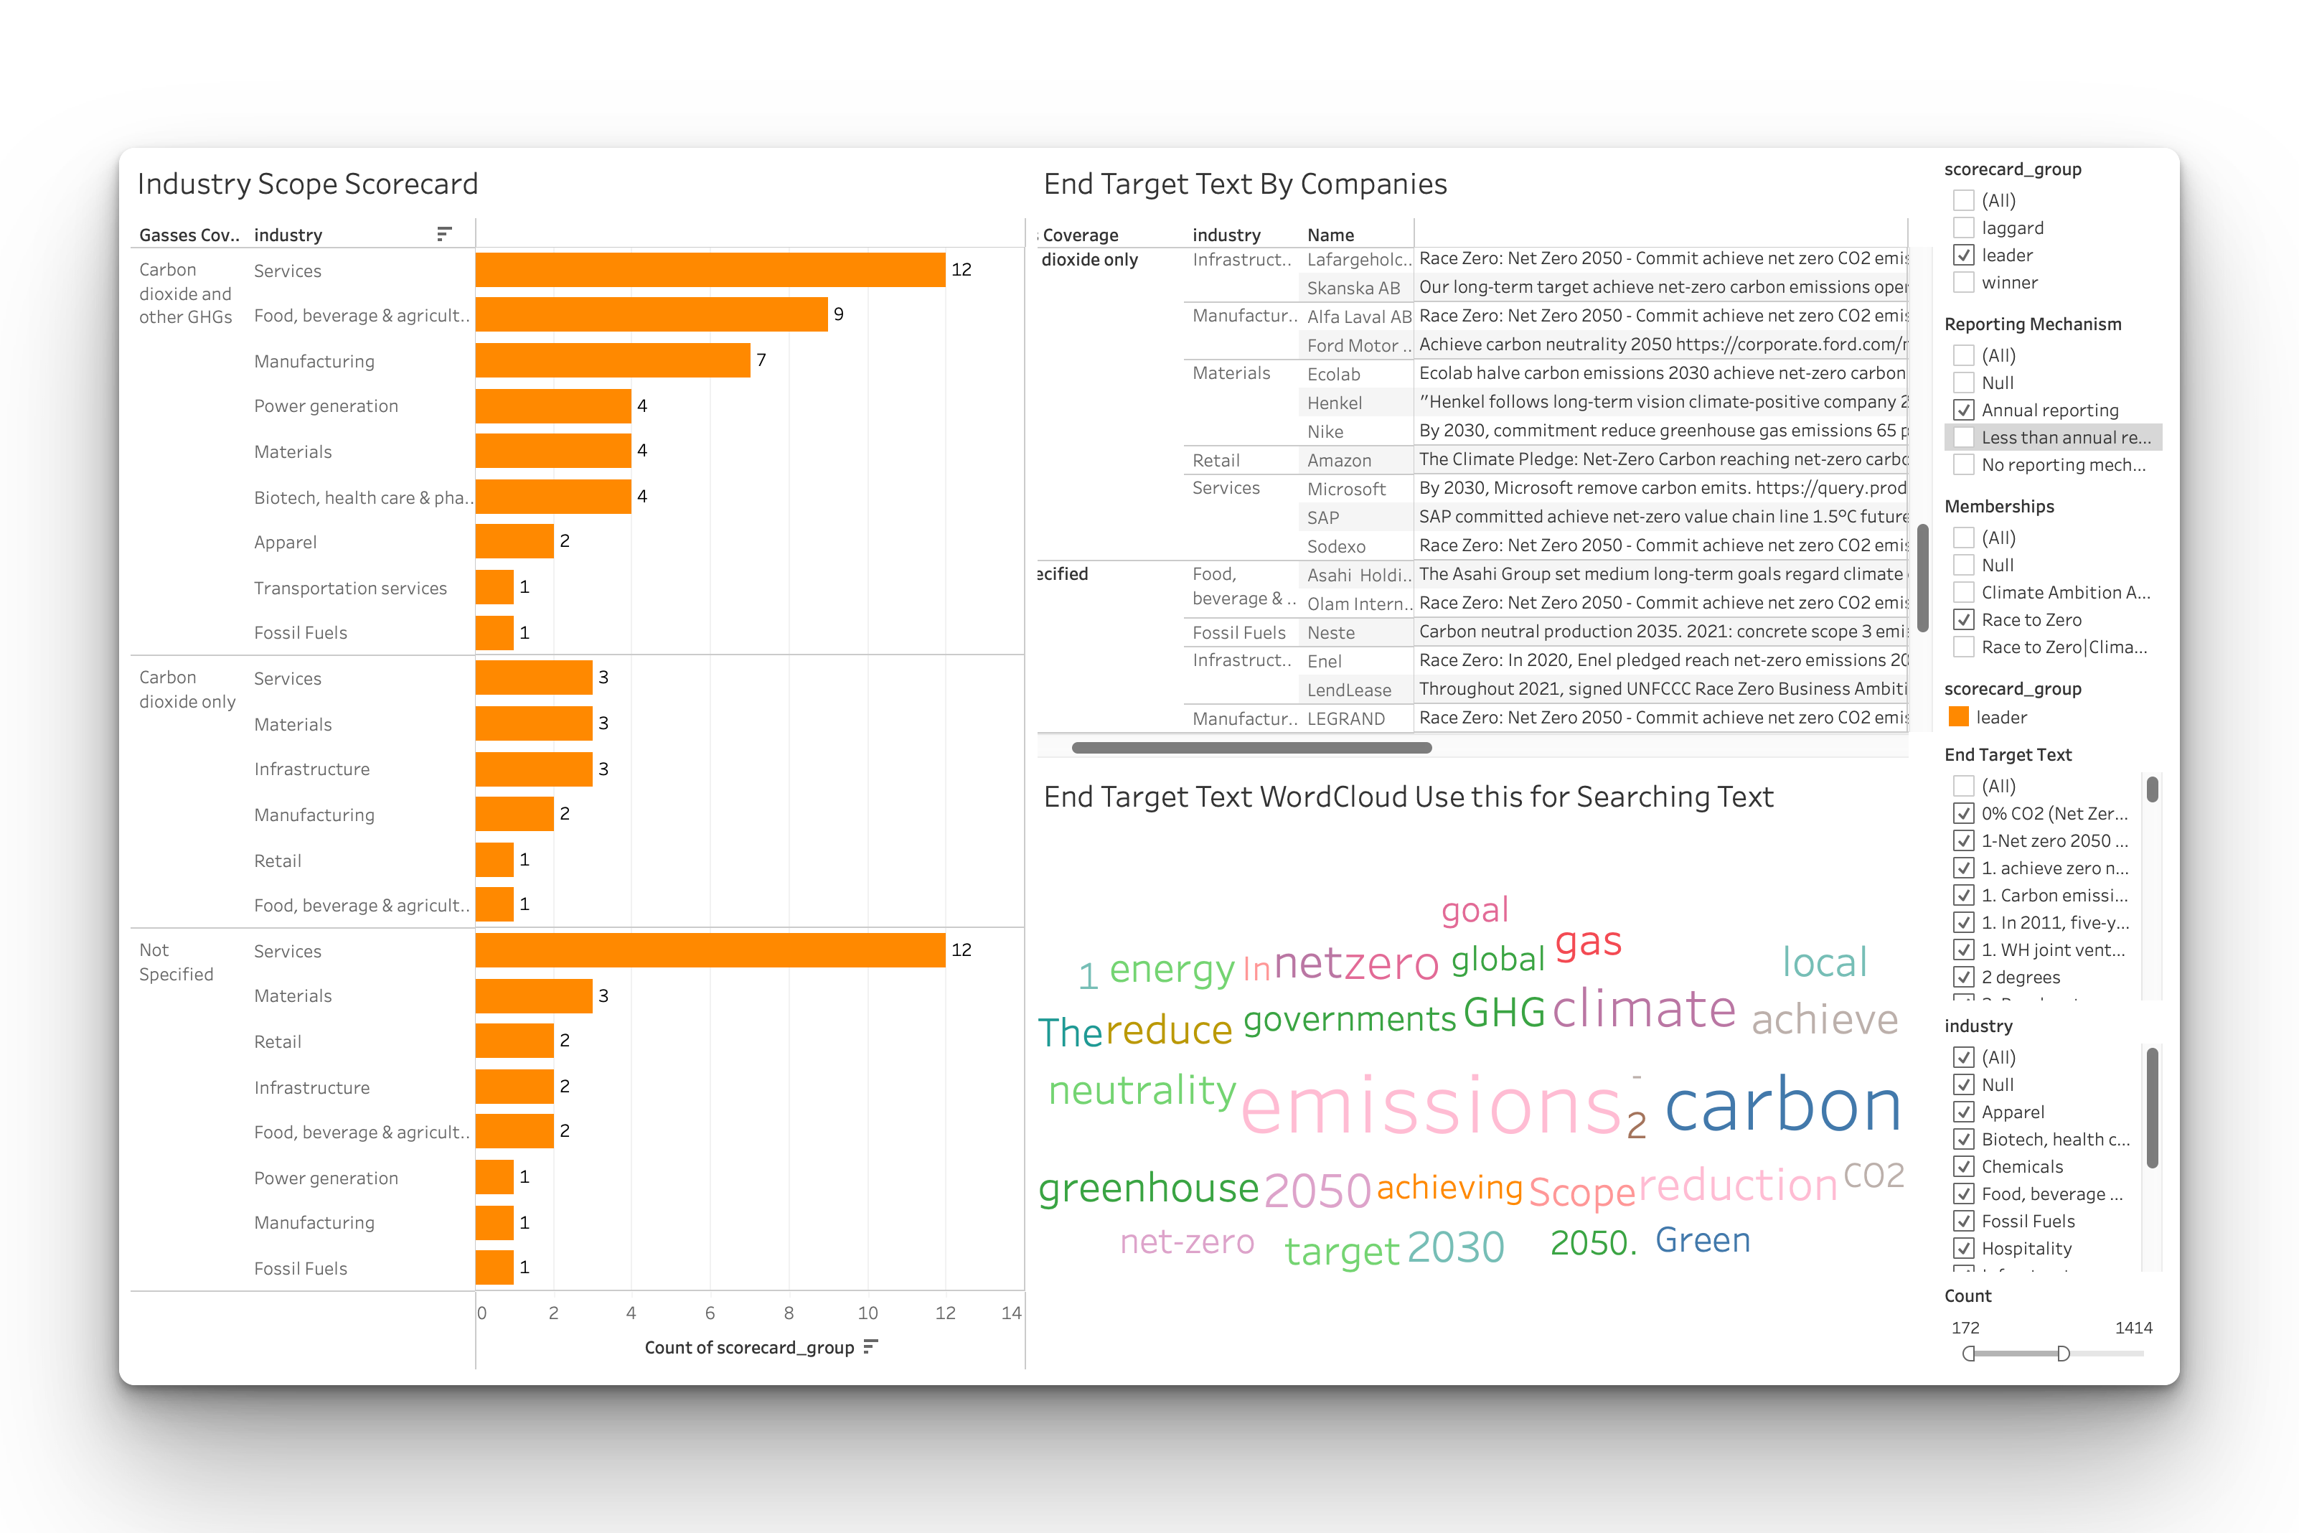
InDUSTRY EMISSIONS SCOPE SCORECARD
Another way to track ambition for leaders and winners is to interact with the Tableau dashboard to filter out the end target texts that each of the groups has disclosed.
The word cloud shows the frequency of the end target text, which can be used to search the most common words within the end target text filter.
Great examples for companies’ end target text such as Asahi Holding and AXA has shown detailed examples and methods on how to reduce GHG emissions.
Using this dashboard can keep track of what the leaders and winners are disclosing to ensure that we can track their ambitions and commitments
Notes:
1. https://www.net0tracker.org/faq.html/#methodology

Slide 11






ROBUSTNESS Scorecard
Robustness Scorecard is an extensive approach to quantify the existing ambition and commitments of company actors towards Net Zero achievement. This is built on top of the scope scorecard analysis from the previous slides. Building on top of the ‘starting line’ benchmark of the Race to Zero criteria and using the existing Net Zero Tracker database, the total score has been computed from 6 dimensions as follows:
Reporting
Mechanism
Gasses Coverage
Emission
Carbon Credit
Offsets
Defined Plan
Memberships
Scope 1, 2, 3

Slide 12
Leading indicators that positively impact average score when...
17x
20.7x
17x
by
by
by
Carbon Credit
Offsets
Reporting
Mechanism
Scope 1, 2, 3
Is published
included
Is Annual Reporting
15.1x
14.7x
12.6x
by
by
by
Defined Plan
Gasses Coverage
Emission
Memberships
Exists
Is Race to Zero
Is CO2 and other GHGs

Slide 13
… versus Lagging Indicators that reduce the average score when…
16.3x
14.9x
by
by
by
14.9x
Scope 1, 2, 3
Reporting
Mechanism
Carbon Credit
Offsets
Is Not published
Is Not Specified
Is Not Specified
15x
14.7x
10.8x
by
by
by
Defined Plan
Gasses Coverage
Emission
Memberships
Not existed
Is Not Specified
Is Not Specified

Slide 14
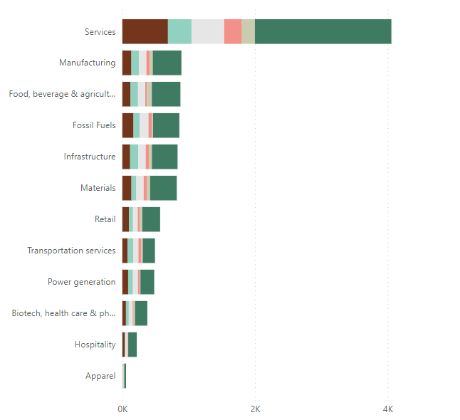
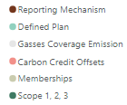
Fossil fuel and power gen companies should improve reporting impact
Analysis: The Stocktake report shows that 49% of companies with net zero targets are fossil fuel companies. However, reporting impact is not proportional to the size of the targeting fossil fuel companies.
Fossil fuels and power gen reporting impact should be more significant due to the business nature of dealing with sources directly related to emissions.
Recommendation: Despite its impact, coverage of fossil fuels and power generation data are more subtle than expected. Companies may improve their reporting standards and comply with stricter environmental policies based on this 6 scoring dimensions. This could also help enhancing their ESG score for future investment opportunities and reducing financing costs.

Slide 15
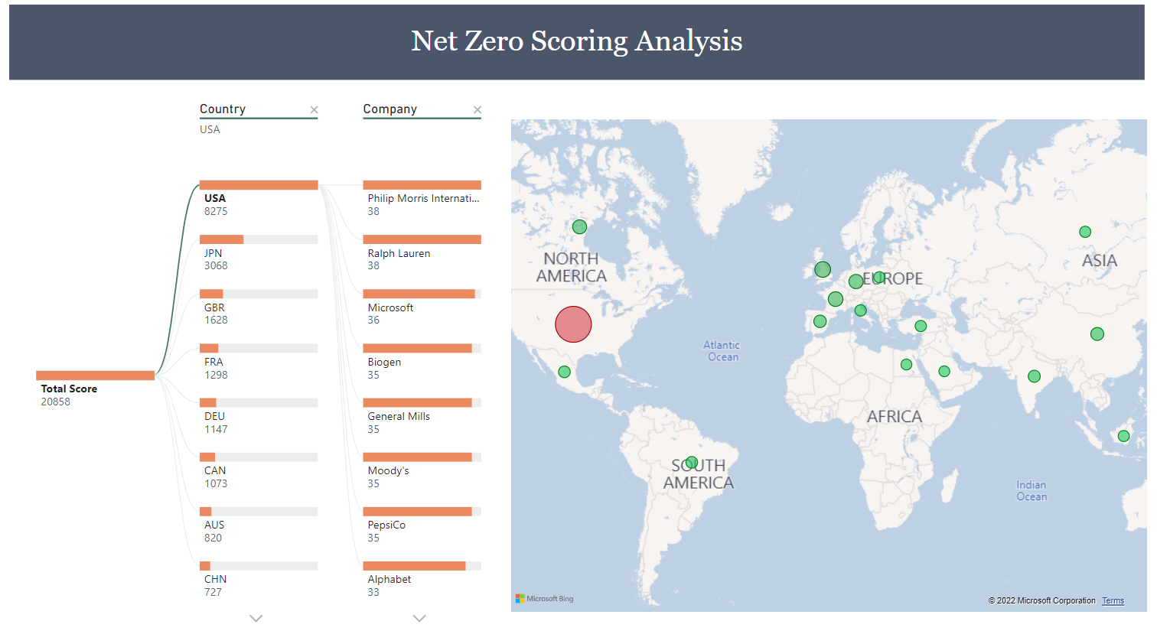
Top 6 countries contribute 60% of total reporting impact globally
Analysis: 3% of country population (“company”) , USA, Japan, United Kingdom, France and Germany contribute to 60% of total scorecard.
Recommendation: This implies that the best practices of reporting standards and requirements that facilitates the tracking of Net Zero Ambition are mainly from a few countries. Therefore, it is suggested that reports from companies of those countries could be used to set up initial guidelines and ESG initiative plans for global collaboration.

Slide 16
DNA CHART: Reduction VS BAU
The hypothesis was to provide a dashboard to track entities using a DNA (Dumbbell) Chart to visualize the difference between the end/interim target emissions against the BAU emissions. This is done to keep the entities accountable for their Reduction vs BAU end/interim targets.
Filters in this includes the entities’ membership and plan coverage to be able to screen the entities accordingly. The rationale for this is to visualize the consistency if the entities’ memberships and plan coverage increased the distance between the target emissions and the BAU emissions. Further distance would indicate the entities’ ambition to stray away from the BAU emissions.
The purpose of this section is to provide a best practice dashboard to visualize the difference between reduction vs BAU as means of new ways to visualize and interpret the data to support the entities’ with reduction vs BAU targets
Link to access the DNA BAU Target dashboard: https://public.tableau.com/app/profile/tap.suksumrun/viz/GlobalStockTakeNetZeroDatathon2022-Master/ScopeScorecardDashboard#2
Notes:
1. https://www.net0tracker.org/faq.html/#methodology

Slide 17
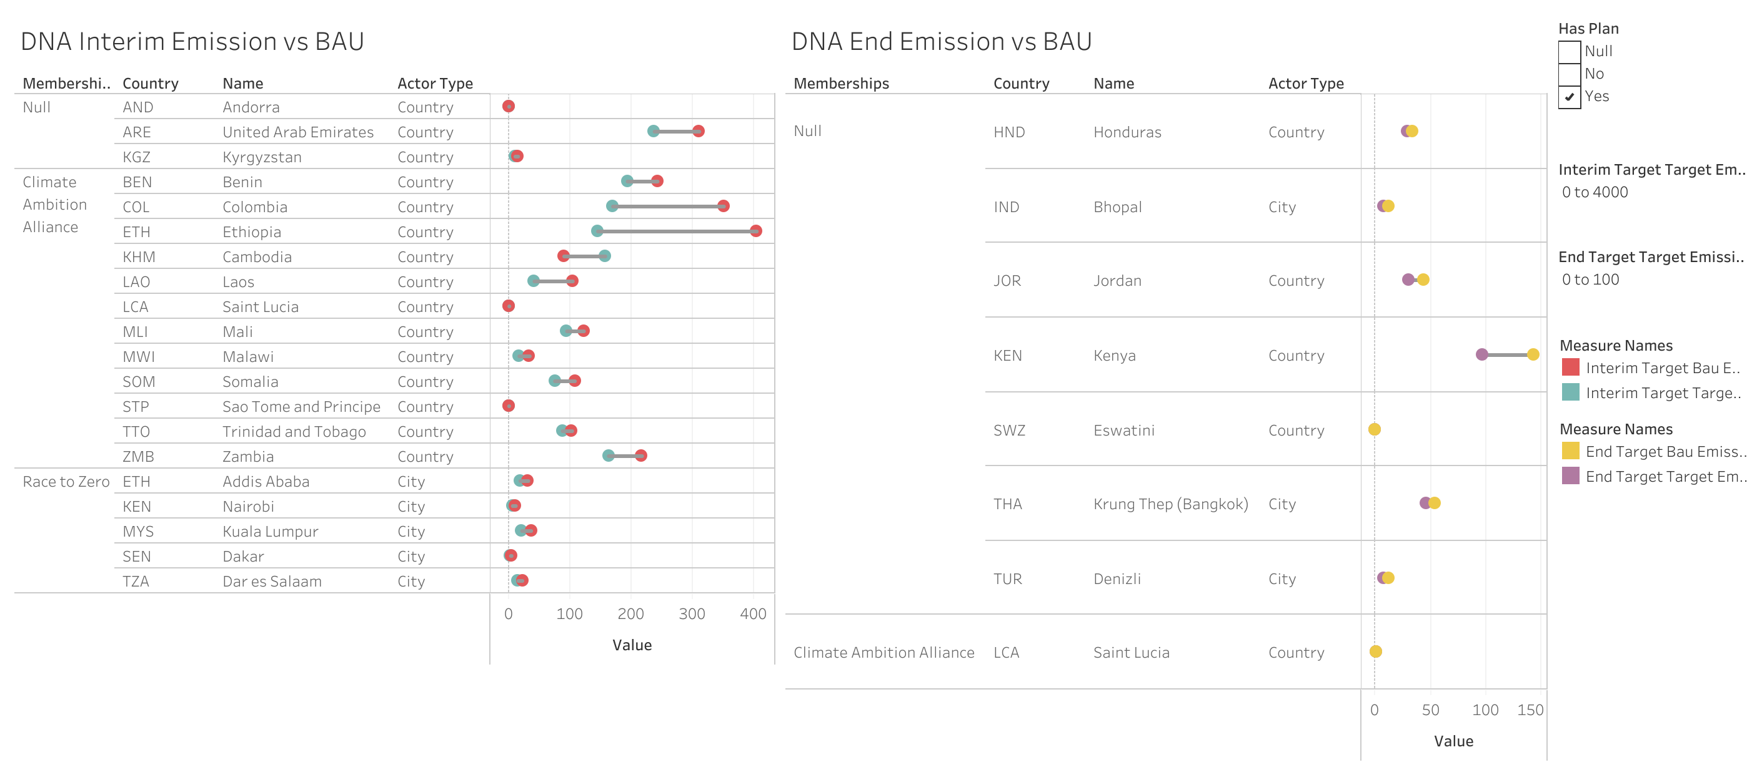
DNA CHART: Reduction VS BAU
Notes:
1. https://www.net0tracker.org/faq.html/#methodology

Slide 18
Bottomline
From the previous set of analyses, it can be inferred that to track ambition in a more transparent way, companies and various actors should be enforced with a stringent environmental policy for company reporting that prompts them to report more frequently to the governmental space.
This includes policy on scope and coverage, planning and reporting processes, more quantifiable standardized information on emissions for future improvements on company reporting standards.
Another outcome from this is to quantify the set of qualitative criteria into a set of numerical visualizations to track the companies’ ambition in a much more data driven way. This can also bring different ways of creating new visualization platforms and ideas for ambition tracking.
This is to provide an incentive to boost their ESG practices and policies so that companies can pursue more sustainable projects and be socially responsible. Understanding this point can improve companies’ motivation to comply with better reporting regulations.
Notes:
1. https://www.net0tracker.org/faq.html/#methodology

